Slide 1
OPC UA
OPC Unified Architecture and Industry 4.0

Slide 2
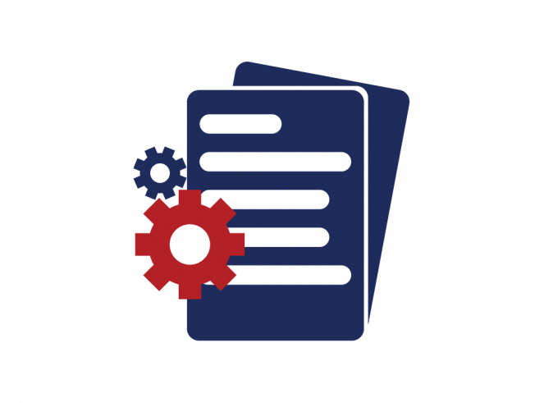
Table of contents
What is an OPC UA?
Initial OPC project
Release of OPC UA
Where is used OPC UA?
Industry 4.0
OPC UA specifications
Traeger library C#
Hirschman project demo
Komax Connect project demo

Slide 3
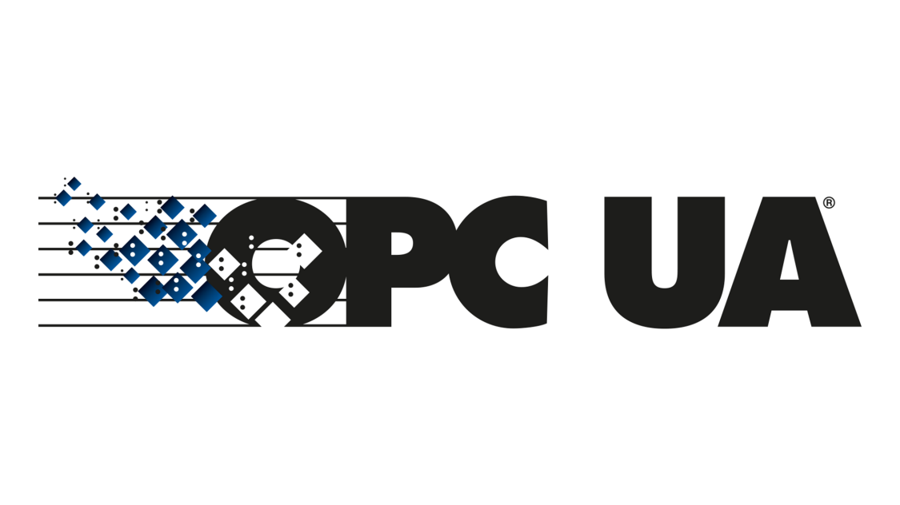
What is an OPC UA?
OPC UA is a data exchange standard for industrial communication (machine-to-machine or PC-to-machine communication).

Slide 4

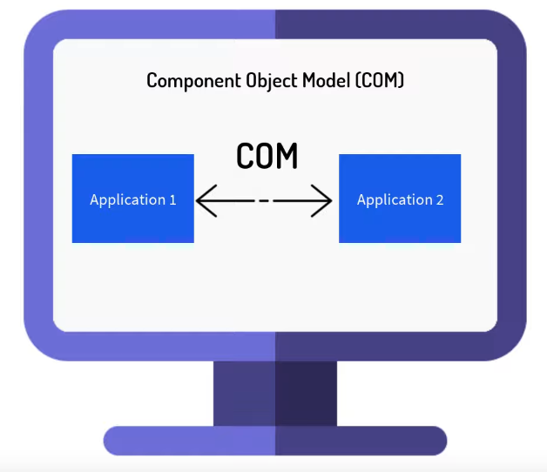
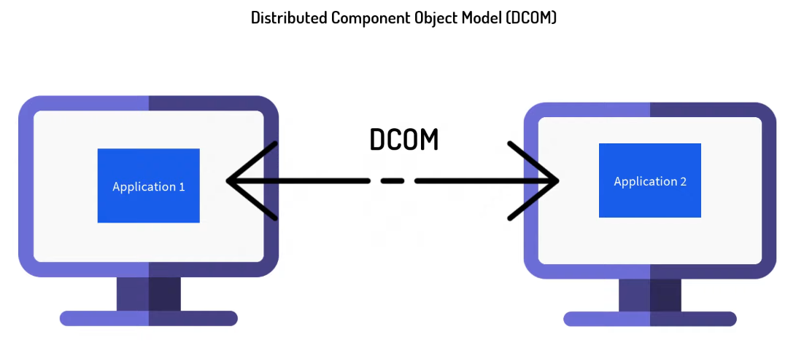
Initial OPC project
OPC UA is a successor of older OPC that was created in 1996 by OPC Foundation.
The communication is based on COM and DCOM which are Microsoft technologies.
It works only on Windows machines and has no so rich features like OPC UA.
Cannot works in Internet.

Slide 5


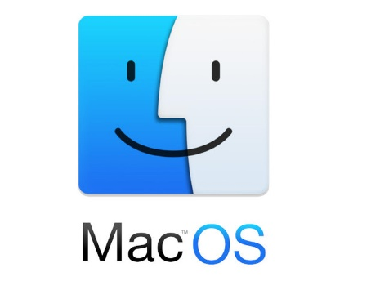

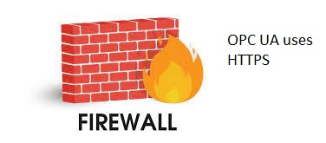
Release of OPC UA
Platform Independence
OPC UA first release is in 2008.
It has many more features than the old OPC.
It is platform independent but not only for Windows.
It has built in security and is Internet friendly oriented (No Firewall problems).
It is designed for work in Internet and specially for Industry 4.0.
It relies on TCP/IP protocol stack and uses Https AND OPC binary protocol.
OPC UA
Firewall friend

Slide 6




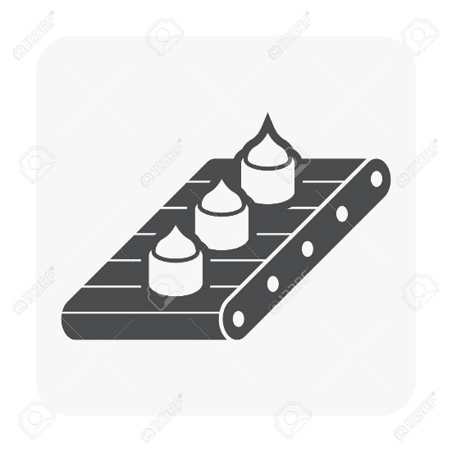
Where is used OPC UA?
OPC UA

Slide 7
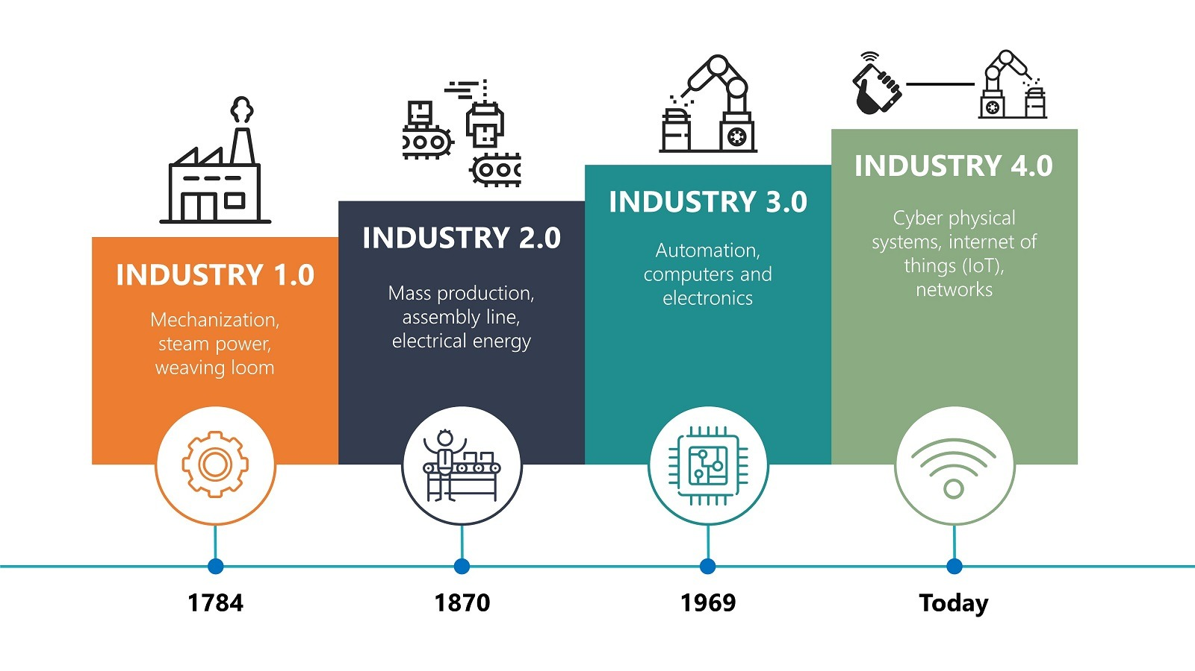
Industry 4.0
Industry 4.0 is the latest evolution of manufacturing.
It refers to the transformation of industry through the intelligent networking of machines and processes with the help of information and communication technology (ICT).
Different kinds of sensors gives the opportunity for making of smart factories where every machine action is traced.

Slide 8
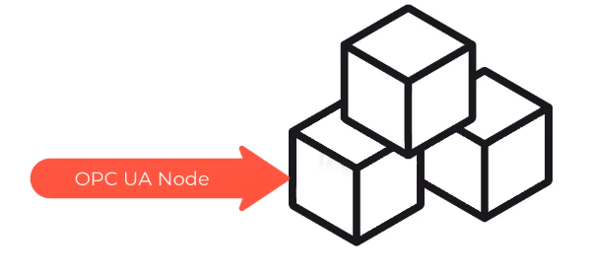
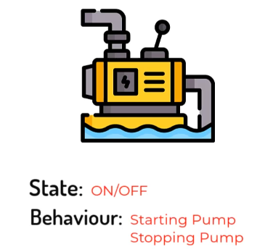
OPC UA Specifications
Information model
Communication architectures
Security
Historical access
Alarms and Events
Programs
"ns=2;s=/FloorOne/Machines/Pump"

Slide 9
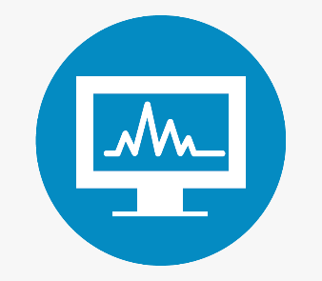

Communication architectures
Pub/Sub model (notifications)
Client/Server model (session)
client
client
server
server
client
session
client
client

Slide 10
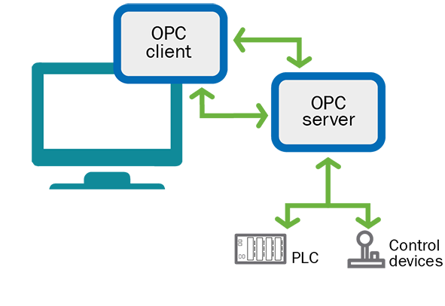
OPC UA simple workflow

Slide 11
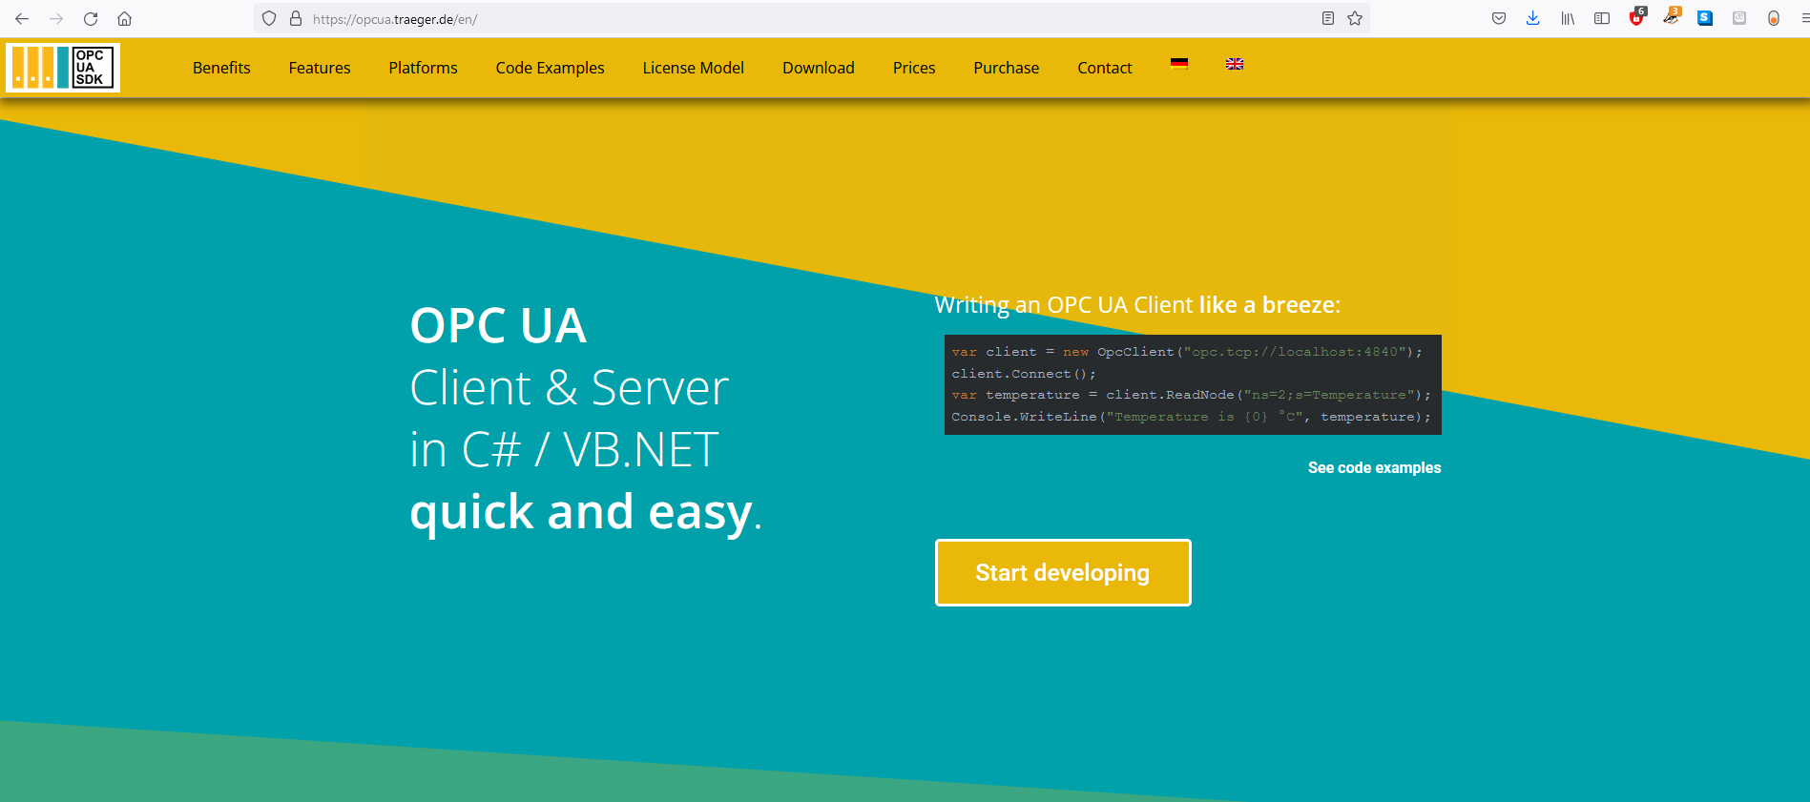
Traeger SDK (demo)

Slide 12
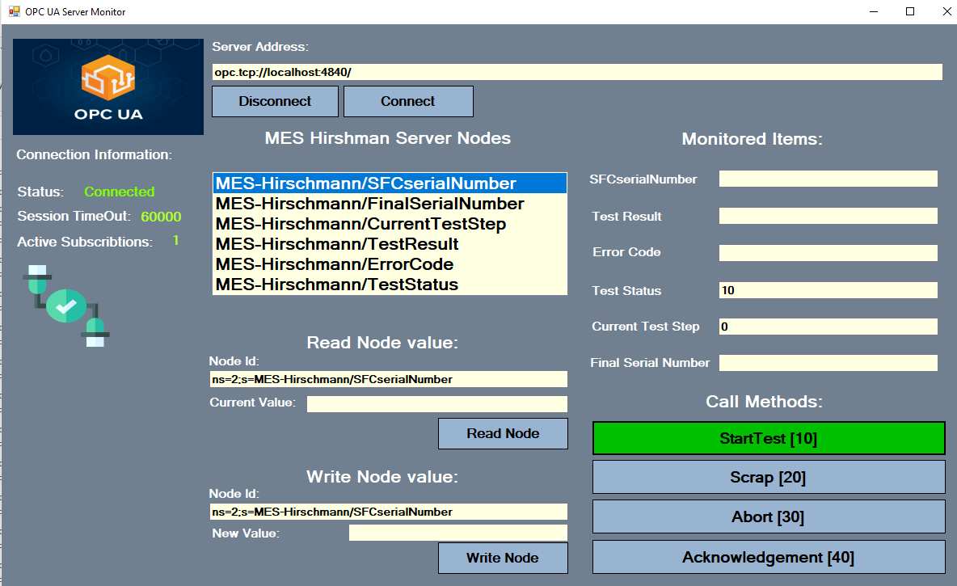

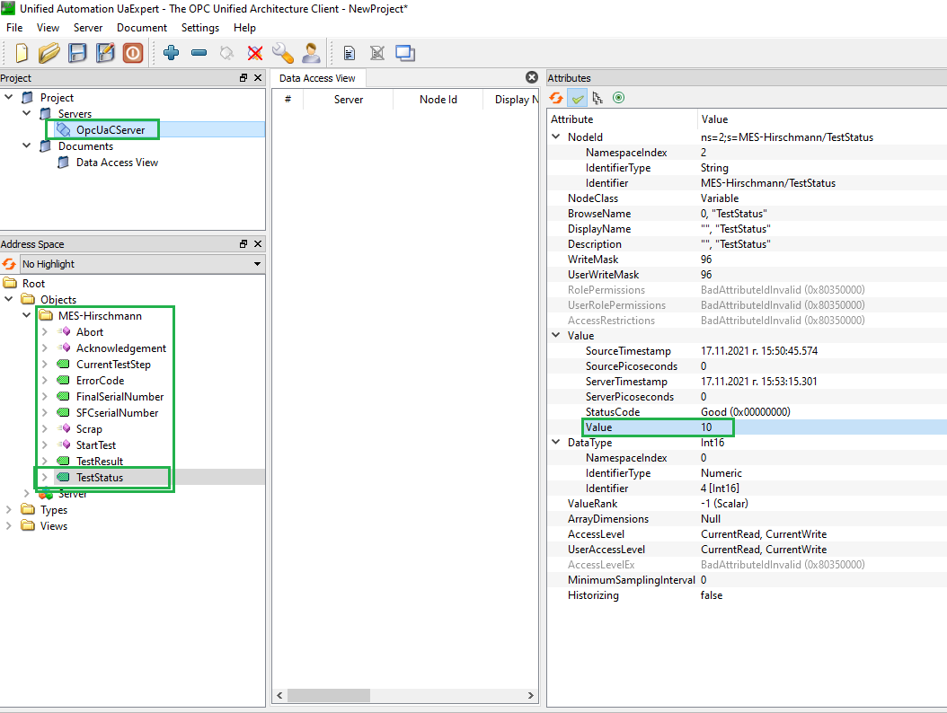
Hirschman project (demo)
client
read
server
write
read
publisher
client
write
subscriber

Slide 13


KOMAX Connect Project (demo)
CS WIN
(OPC UA client
– COM object)
KOMAX Gateway
OPC UA server (Win service)
Cloud dashboard
read/write data
read data
OPC UA
OPC UA

